Slide 1
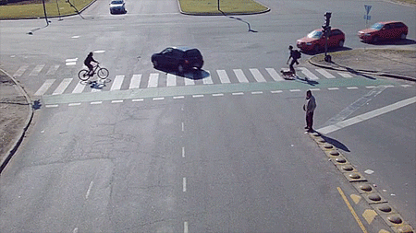
Chicago Traffic Accident Analysis
Gavriliuc Bogdan IA-213

Slide 2
The main objectives of the analysis include:
1 Identification of factors affecting the frequency and severity of crashes.
2Identification of the most dangerous road sections.
3 Predicting trends in traffic accidents.

Slide 3
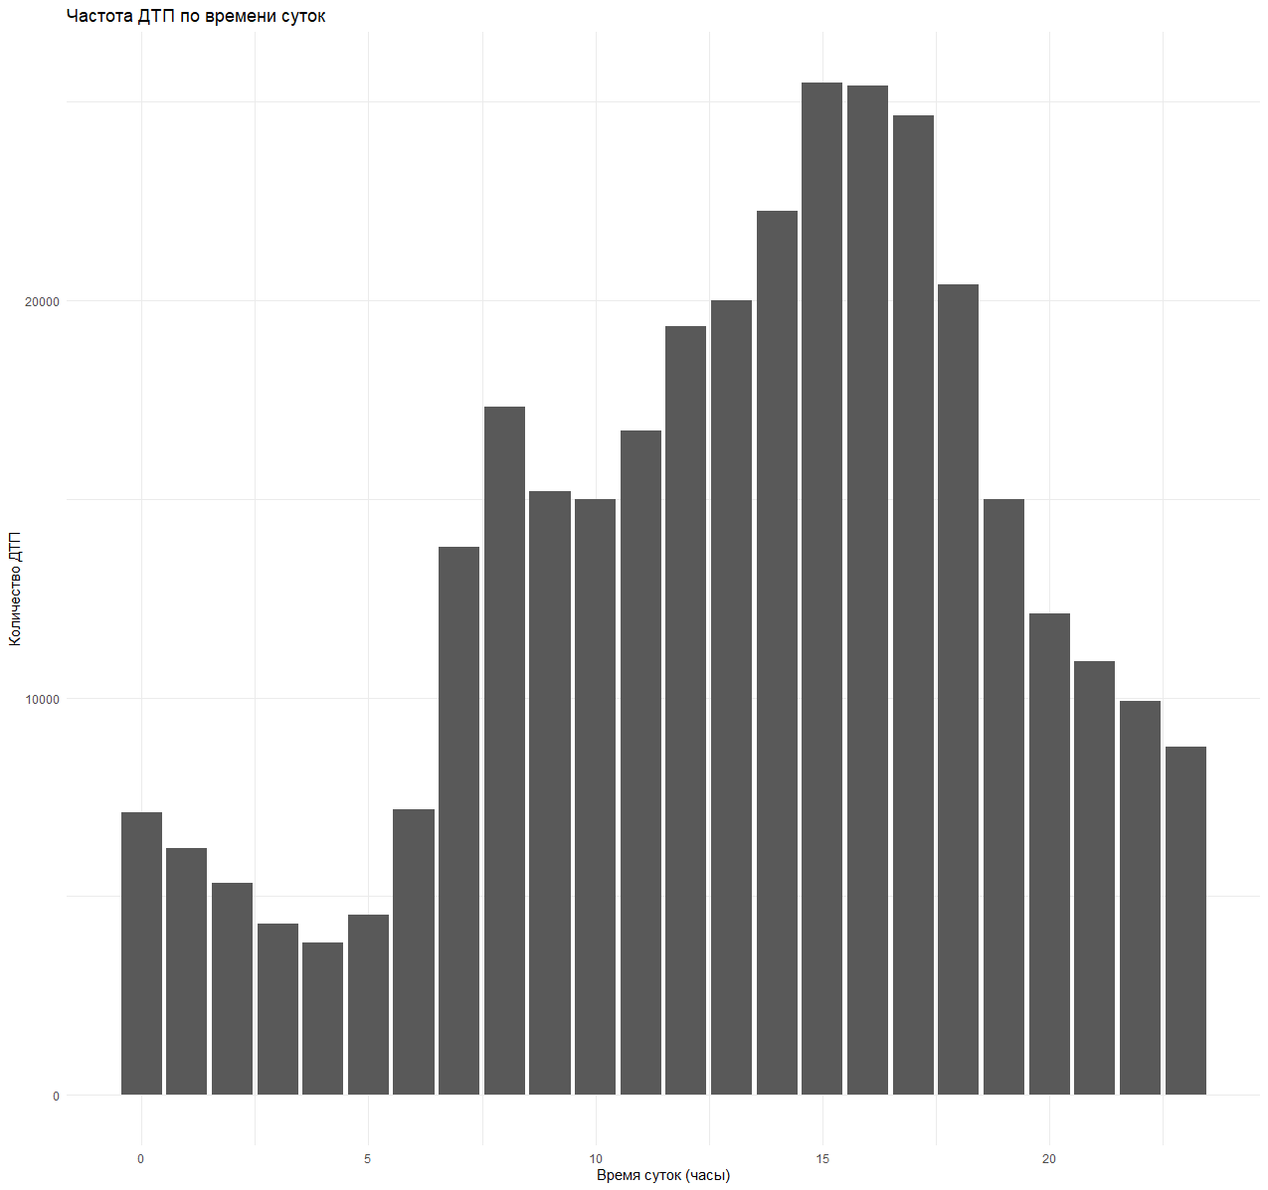
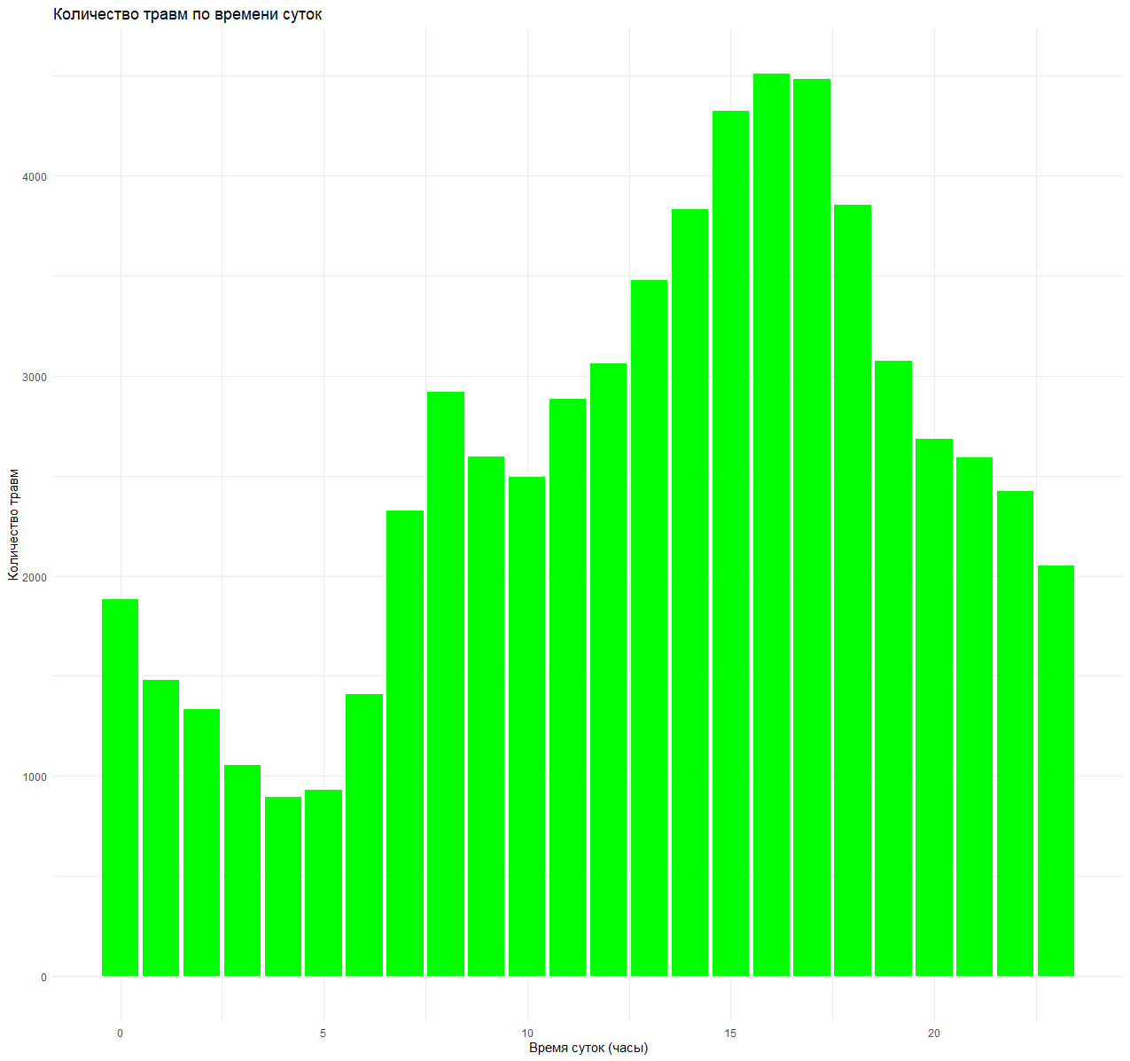

Frequency of accidents and number of injuries depending on time of day
time
time
Frequency
Injuries

Slide 4
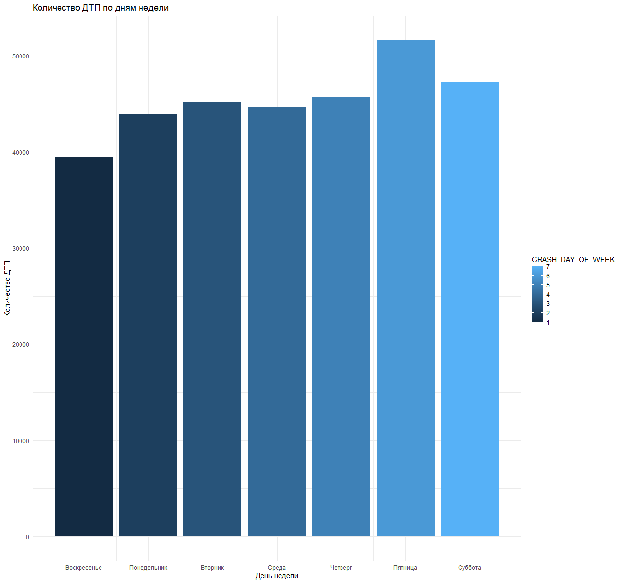
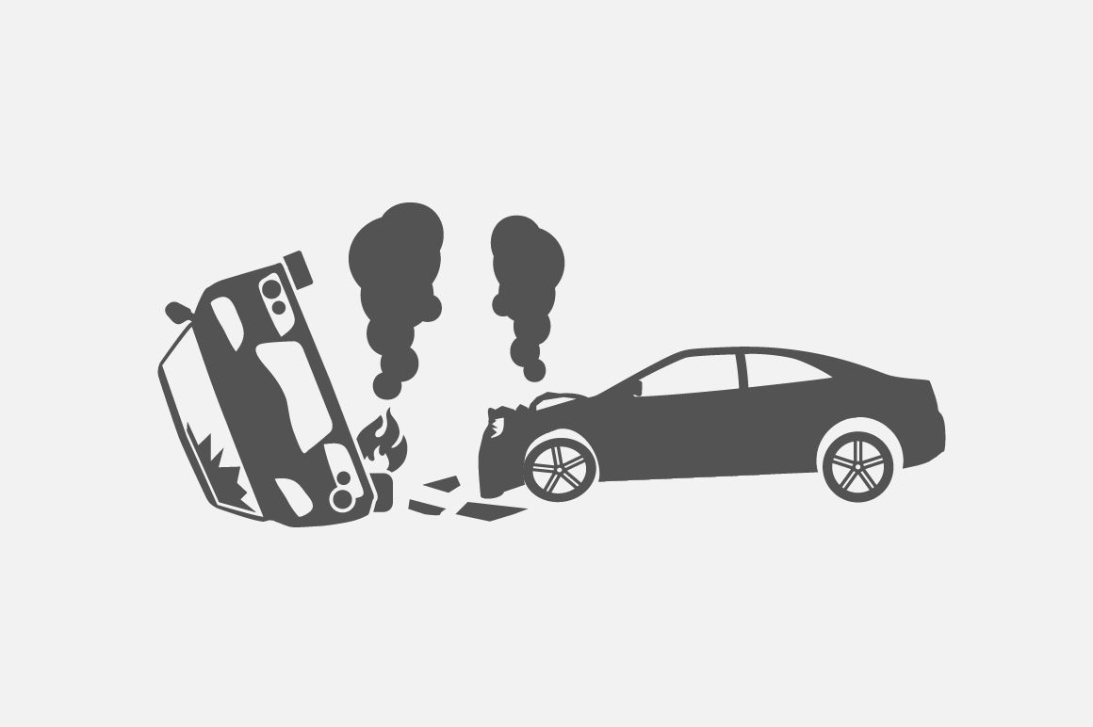
Number of road accidents by day of the week
Friday is the day with the most traffic accidents!!!
Count
Sunday Monday Tuesday Wednes. Thursday Friday Saturday

Slide 5

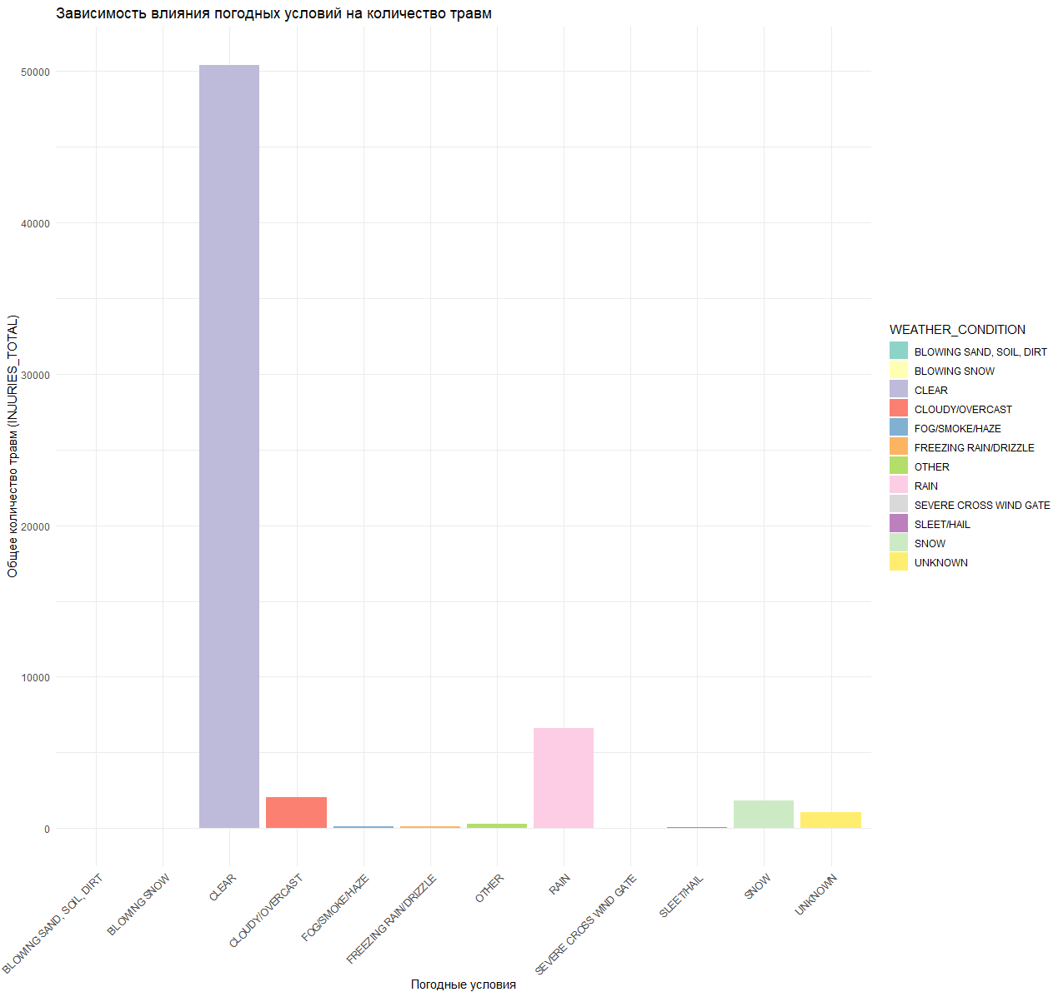
Impact of weather conditions on the number of injuries

Slide 6
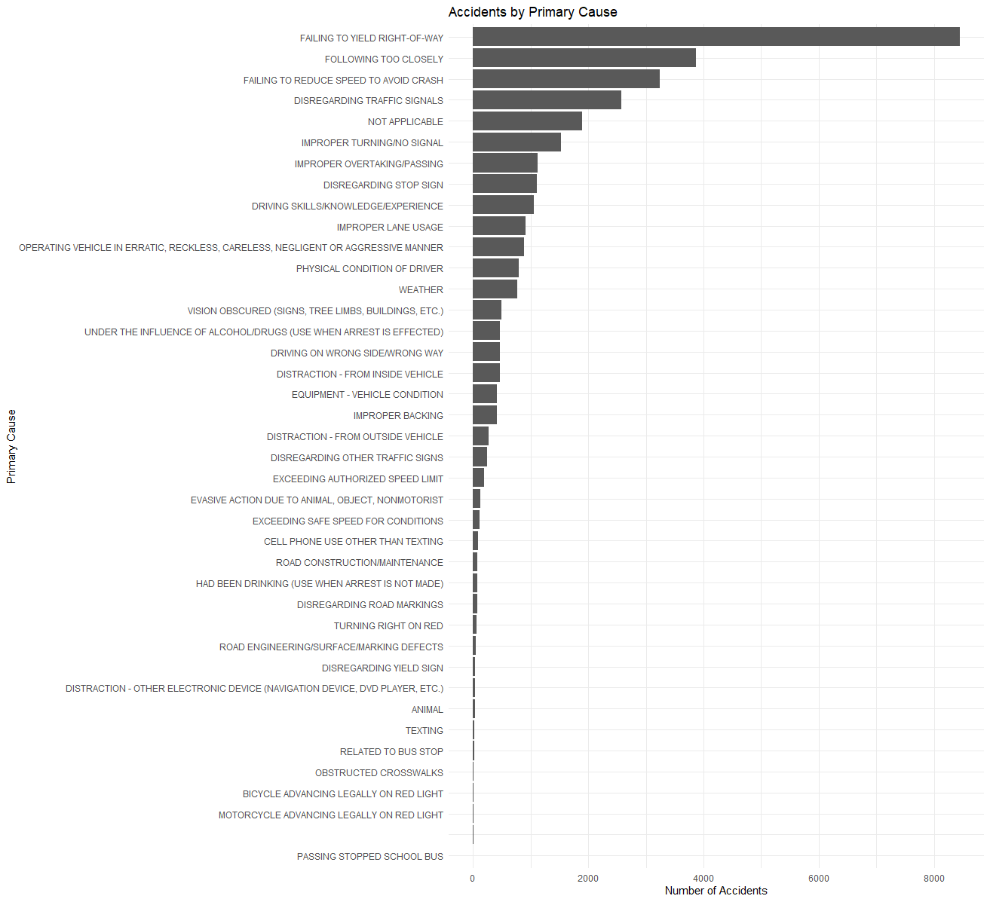
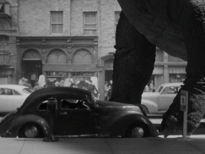
Accident by Primary Cause
Cause
Not a single car was damaged by the dinosaur
Number of Accidents

Slide 7
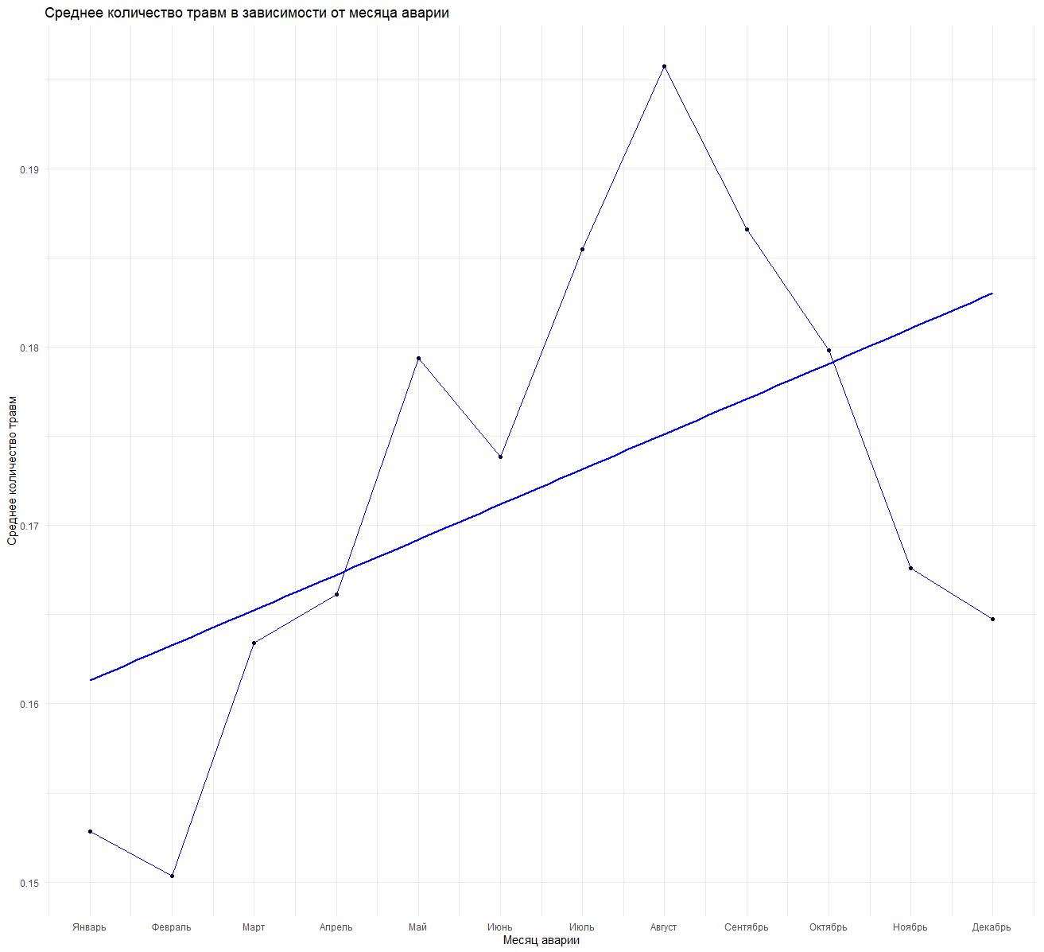

Average number of injuries by month
August is the most dangerous month
January February March April May June July August Septem. Octbr. Novemb. December

Slide 8
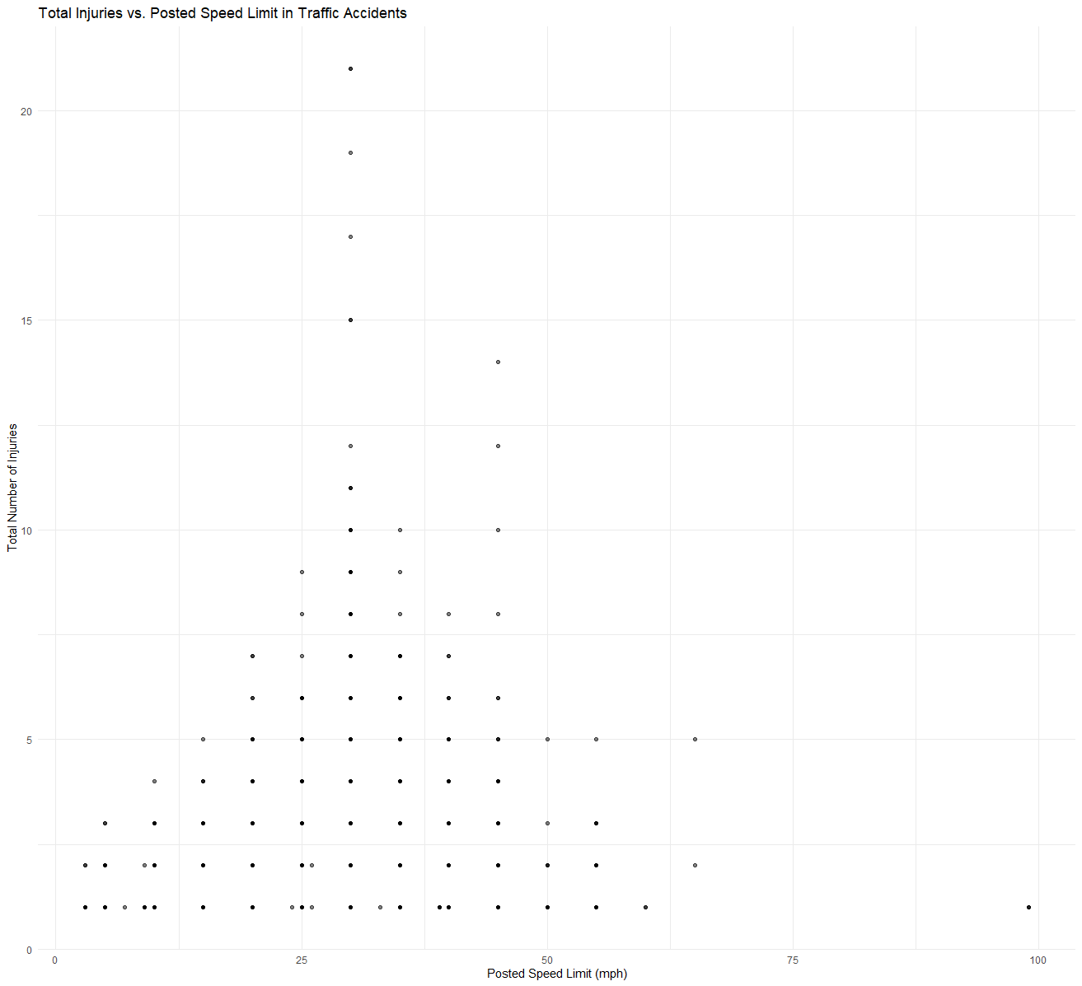
Posted Speed Limit
Total Injuries vs. Posted Speed Limit in Traffic Accidents
Total Injuries

Slide 9

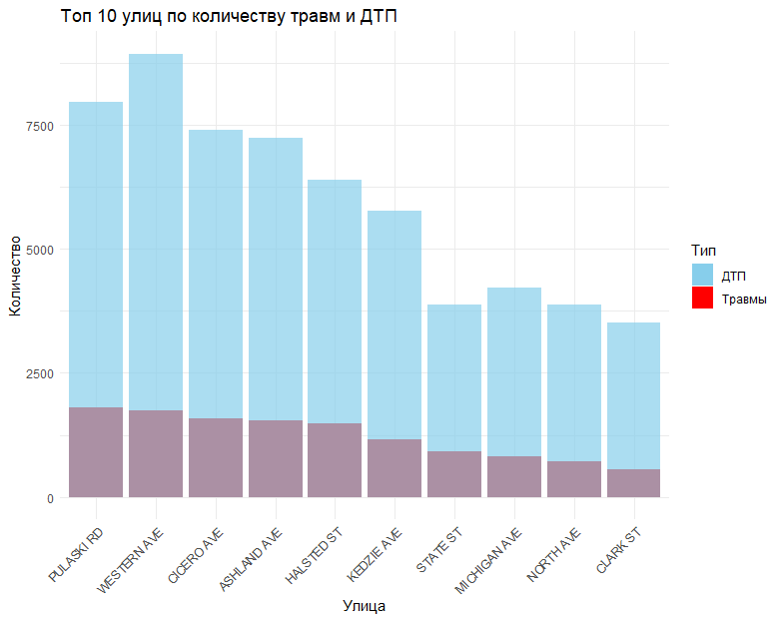
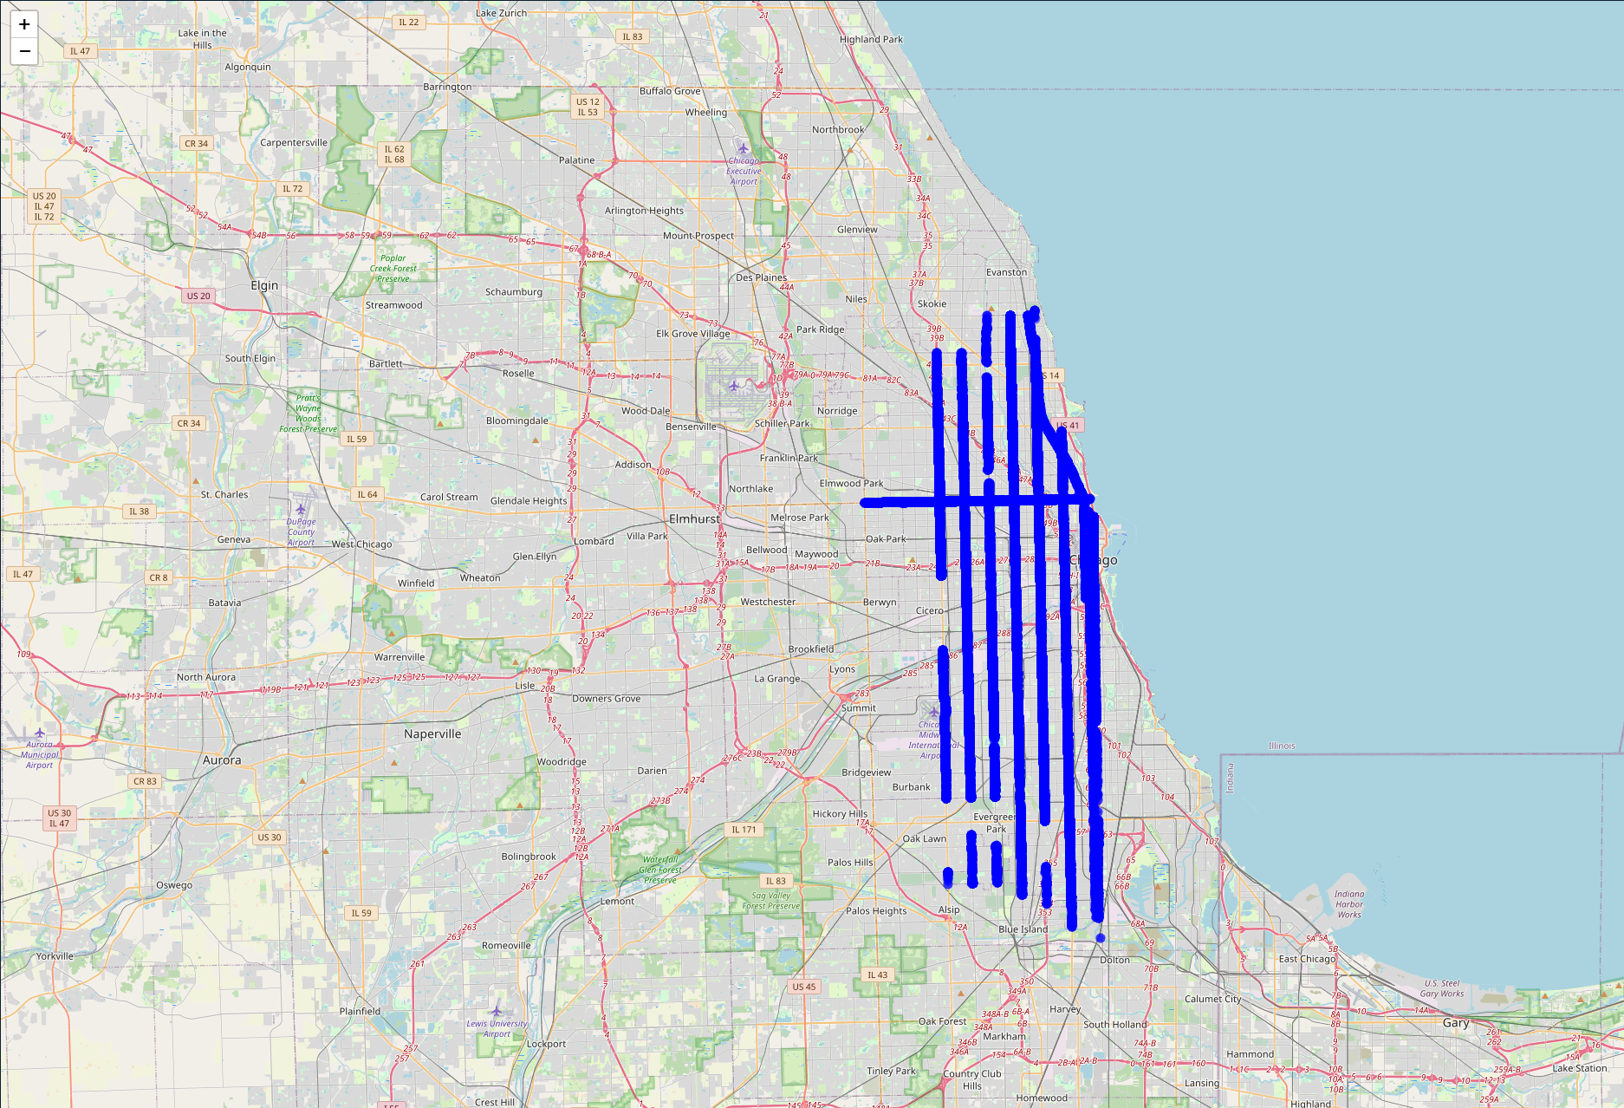
Top 10 streets by number of injuries and accidents
Display top streets on the map

Slide 10
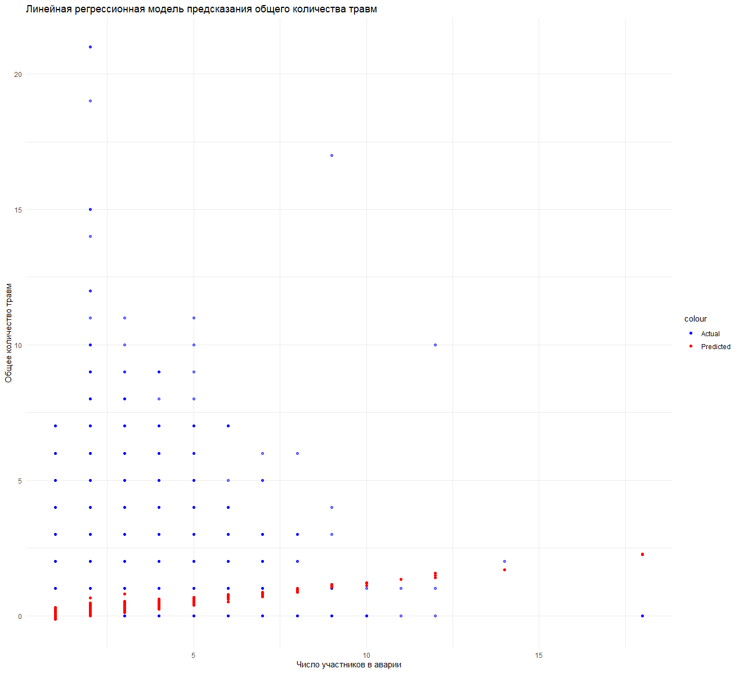
Linear regression model for predicting total number of injuries
The number of injuries rises with the number of people involved in accidents

Slide 11
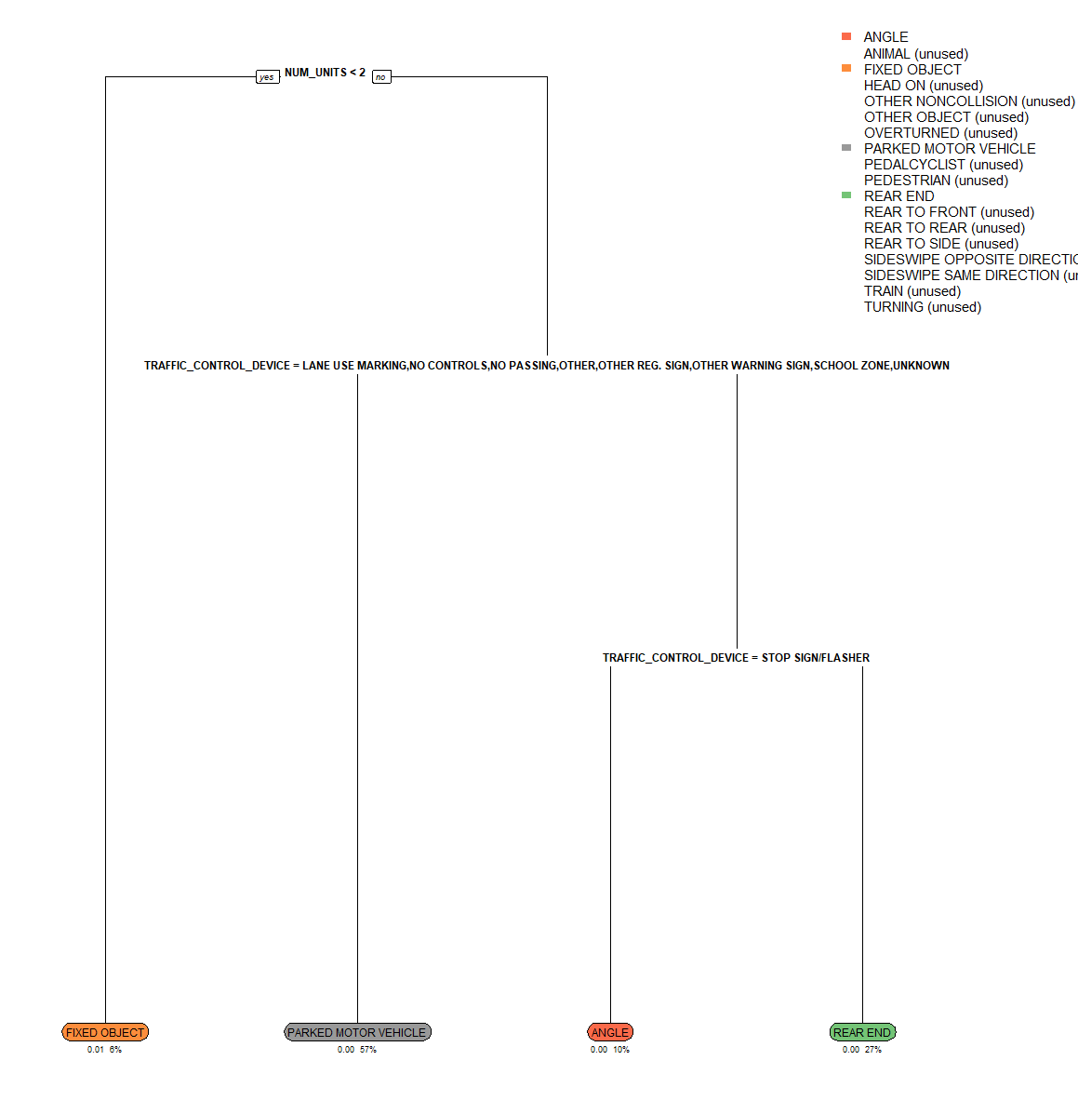
Multiclass classification model

Slide 12
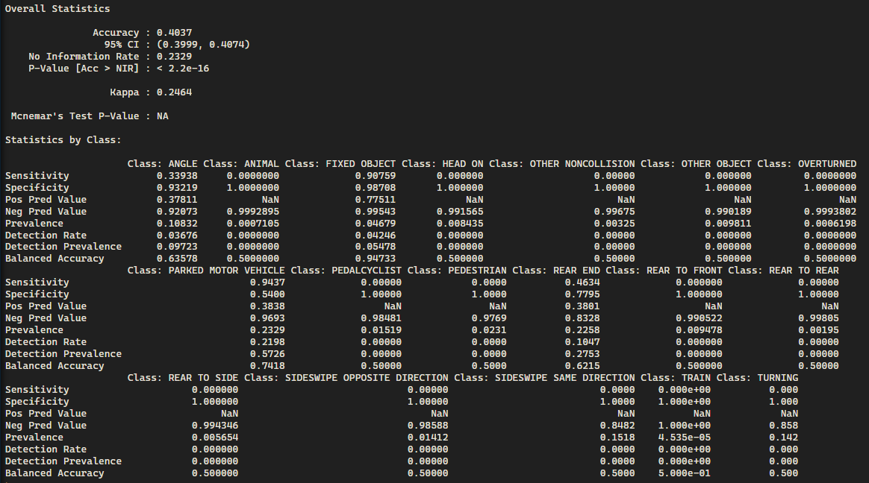
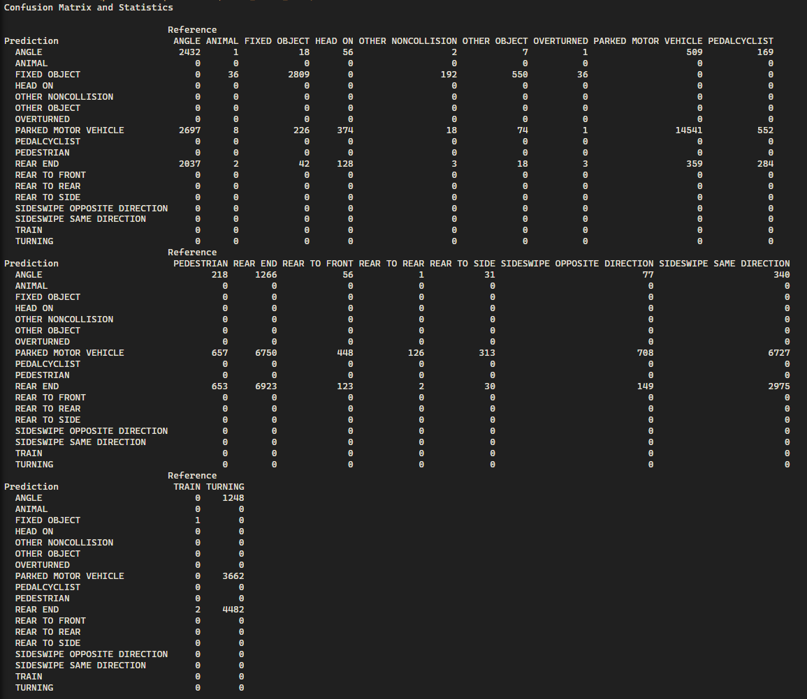
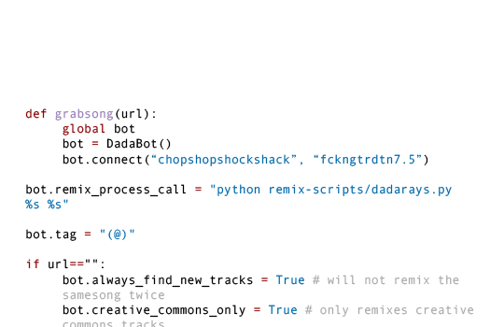
Multiclass classification model

Slide 13
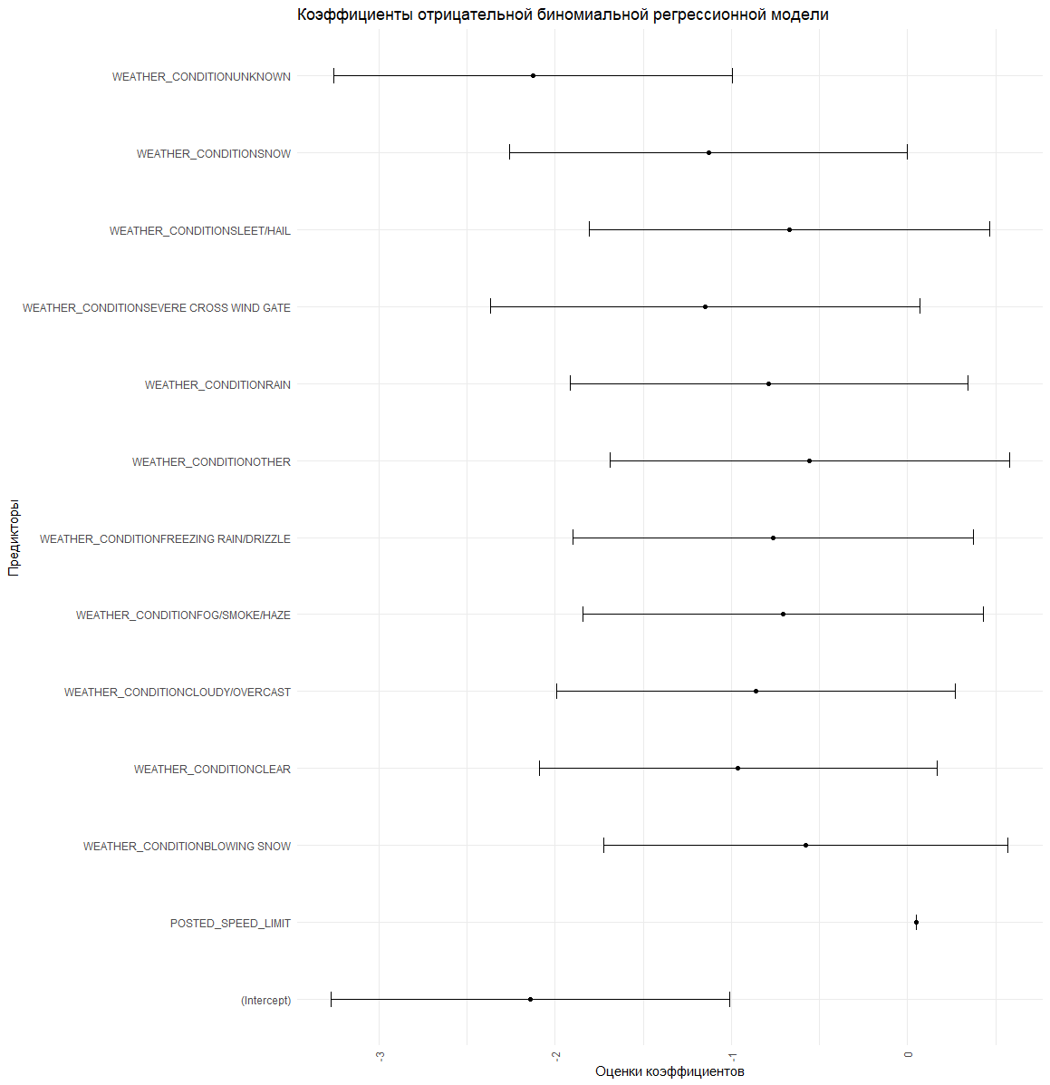
Coefficients of the negative binomial regression model
Vertical lines indicate the range of standard errors of each estimate, and the direction and magnitude of the coefficients reflect the effect of the predictors on the dependent variable.

